Slide 1

Hypothesis Testing using Statistical Tests

Slide 2
Learning Objectives
By the end of this session, you will be able to:
Understand when to use which statistical tests
Apply and practice the various steps of Hypothesis Testing
Understand the process of one sample and two sample tests.
Draw inferences and conclusion.
Understand the concept of degrees of freedom

Slide 3
What is a Hypothesis and Hypothesis Testing?
An assumption or educated guess about a population parameter.
Tested using sample data.
Hypothesis testing is like a detective game where you :
1. start with an assumption (a hypothesis);
2. then collect evidence (data) to decide whether
3. your assumption is likely to be true or not.
It’s a way of making decisions or inferences about a population based on a sample of data.

Slide 4
Steps in Hypothesis Testing (Recap)
1. Formulate H₀ and H₁
1
2. Choose α
2
3. Select Test
3
4. Calculate Test Statistic
4
5. Make Decision
5

Slide 5
Reference
Test statistics$= \frac{Sample statistic−Population Parameter}{Standard Error}$
Commonly used Critical z values
Significance Level (⍺) | Two-Tailed Test | One-Tailed Test (Left) | One-Tailed Test (Right)
0.01 | ±2.58 | -2.326 | +2.326
0.05 | ±1.96 | -1.645 | +1.645
0.10 | ±1.645 | -1.282 | +1.282

Slide 6
Statistical Test Computations

Slide 7
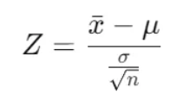
Testing of Mean – One sample
Testing of Mean – One sample – Large Sample(>=30) and Population SD is known
Test used: Z test (as the sample size is large and population SD is known)
Central limit theorem states that if you take a sample size of 30 or more, then the distribution tends to become normally distributed.
Test statistic:

Slide 8
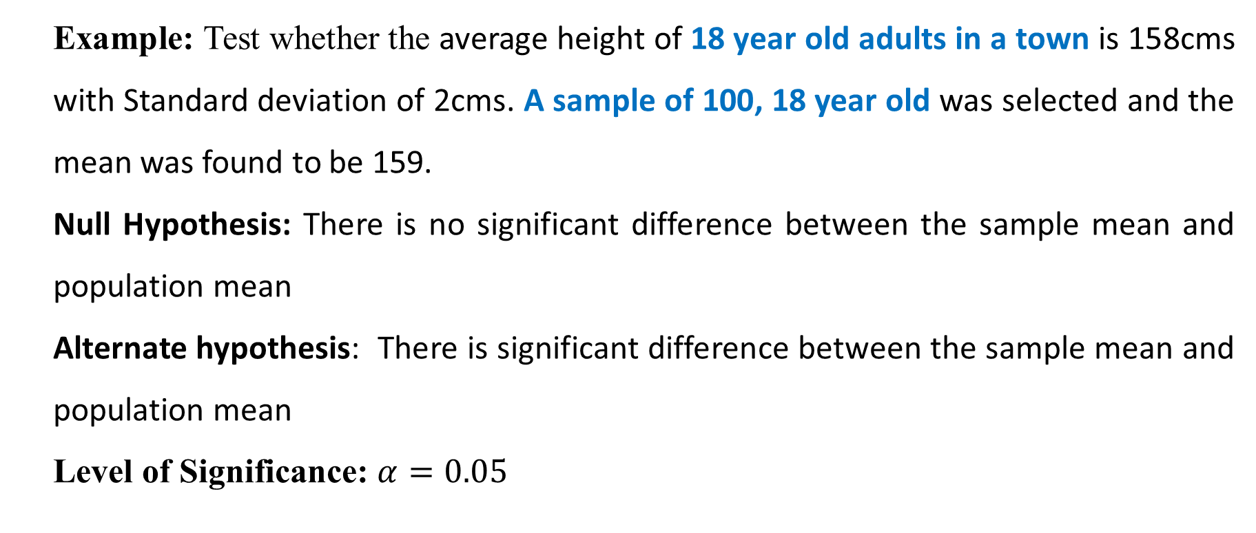
Testing of Mean – One sample
Testing of Mean – One sample – Large Sample(>=30) and Population SD is known
Example: Test whether the average height of 18 year old adults in a town is 158cms with Standard deviation of 2cms. A sample of 100, 18 year old was selected and the mean was found to be 159.
Null Hypothesis: There is no significant difference between the sample mean and population mean
Alternate hypothesis: There is significant difference between the sample mean and population mean
Level of Significance: $α=0.05$

Slide 9
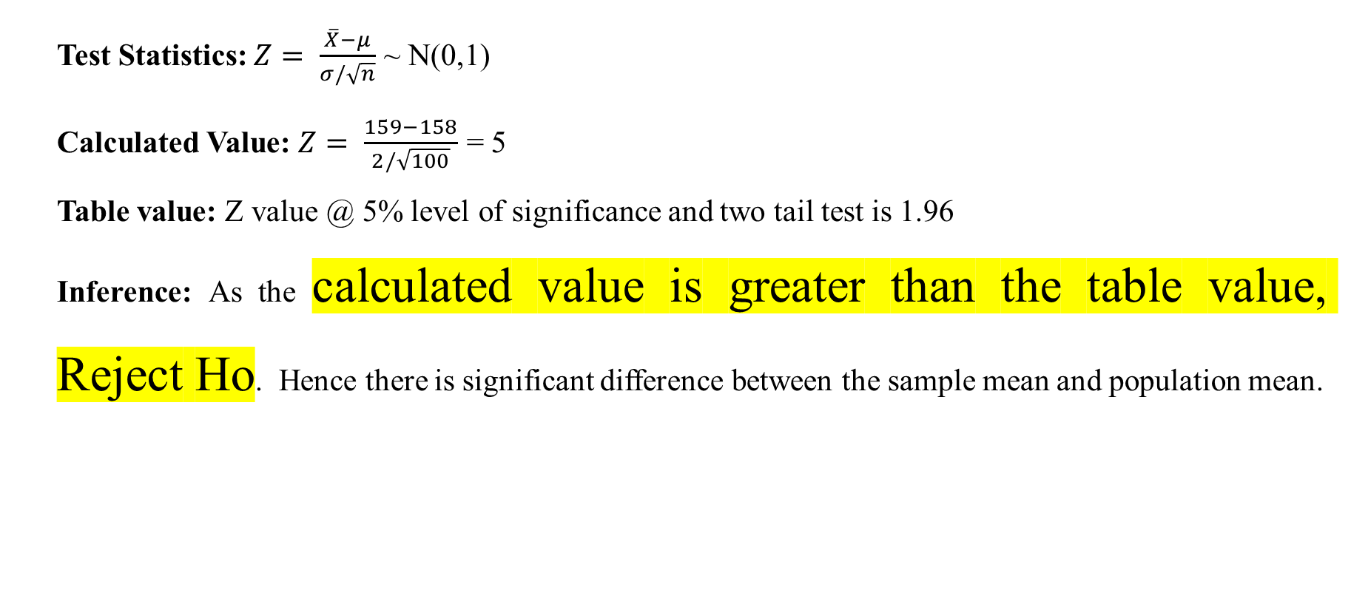
Calculation and Result
Test Statistics: $Z= \frac{\overline{X}−μ}{σ/\sqrt{n}}$ ~ N(0,1)
Calculated Value: $Z= \frac{159−158}{2/\sqrt{100}}$ = 5
Table value: Z value @ 5% level of significance and two tail test is 1.96
Inference: As the calculated value is greater than the table value, Reject Ho. Hence there is significant difference between the sample mean and population mean.

Slide 10
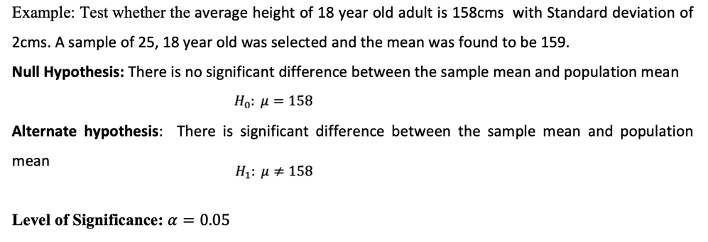
Testing of Mean – One sample
Testing of Mean – One sample – Small Sample(<30) and Population SD is known

Slide 11
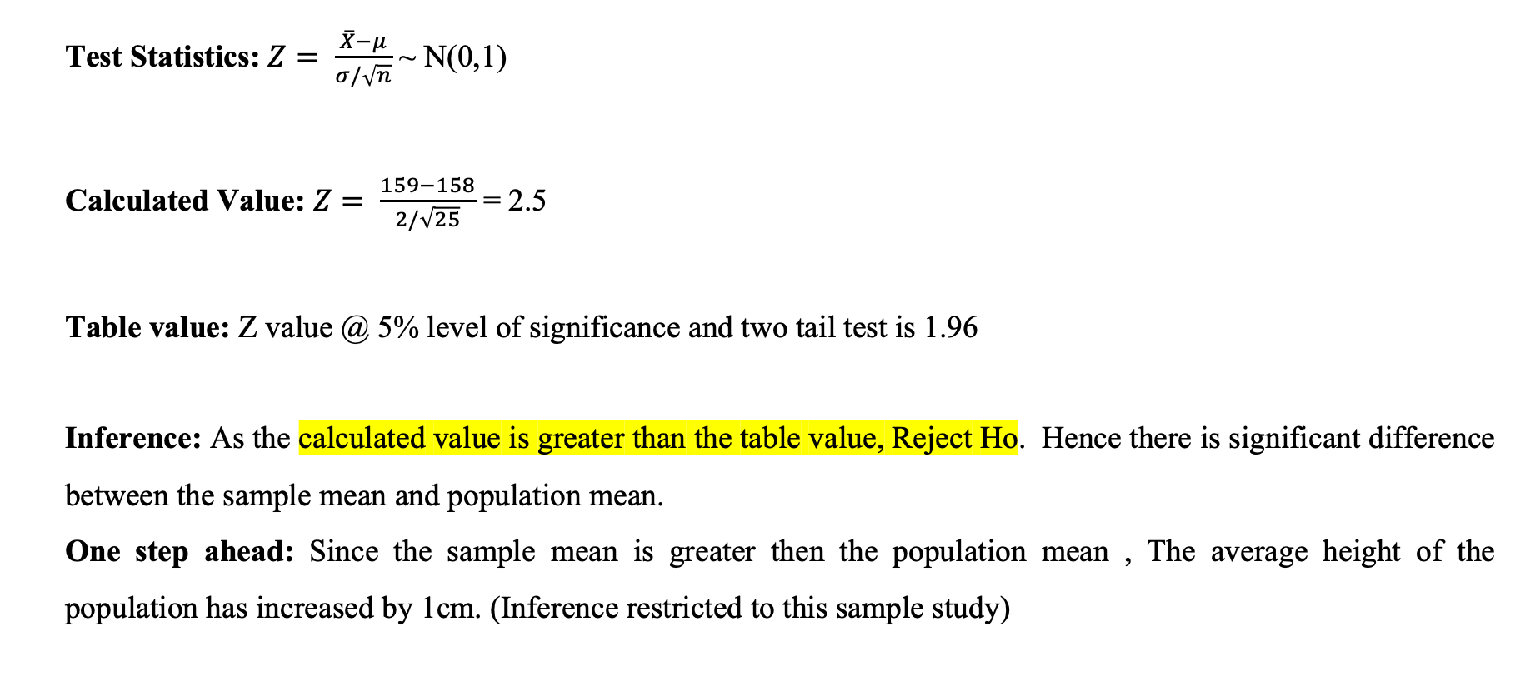

Slide 12
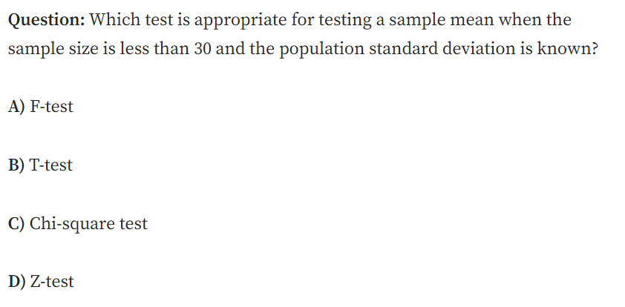
MCQ

Slide 13
MCQ
MCQ
Answer: D) Z-test
Explanation: Even though the sample size is small, if the population standard deviation (SD) is known and the data is approximately normally distributed, a Z-test can still be used. However, if the sample size is small and the population SD is unknown, a T-test would be more appropriate.

Slide 14
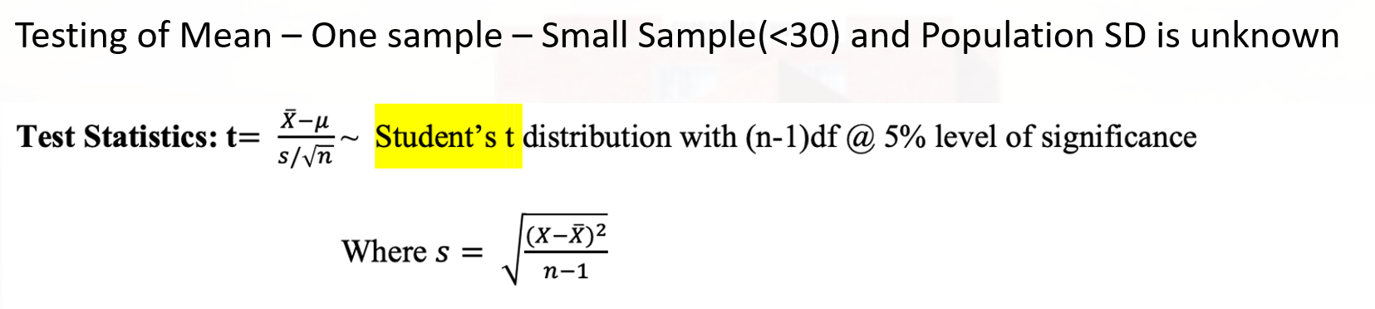
Testing of Mean – One sample
Small Sample (n < 30): We use this specific test when we have a small group. Small groups are "jittery" and less predictable than large groups.
Population SD is unknown: We don't know the exact "spread" of the entire world, so we have to guess the spread based on our small group (s).
Level of Significance (5%): This is our "confidence bar." We are saying, "I only want to be wrong 5% of the time.“
Degrees of Freedom (n-1): This is a technical adjustment. If you have 10 people, you have 9 "degrees of freedom." It accounts for the uncertainty of small samples. (will discuss later slide).
S

Slide 15
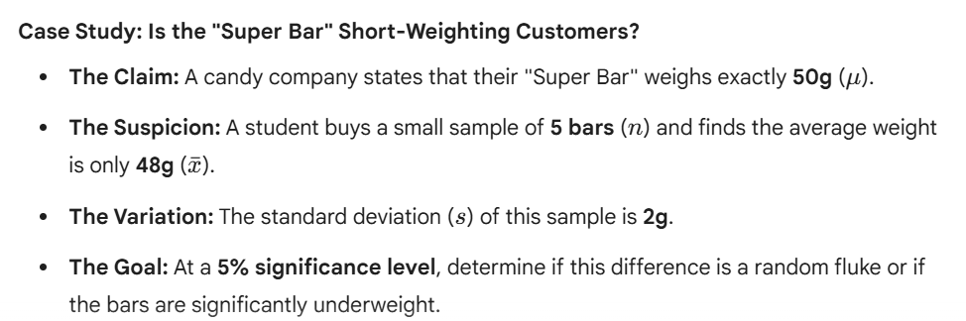
Testing of Mean – Problem Statement

Slide 16
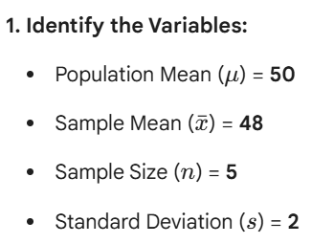
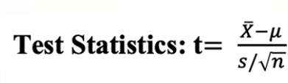
Testing of Mean – Calculation

Slide 17
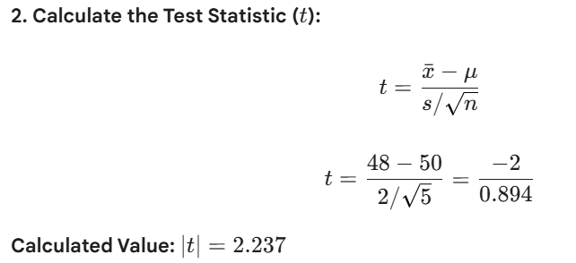
Testing of Mean – Calculation

Slide 18
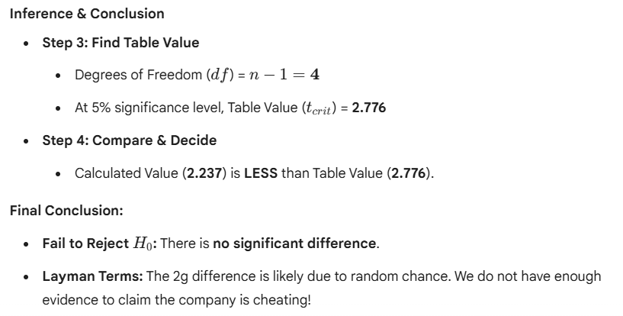
Testing of Mean – Result

Slide 19
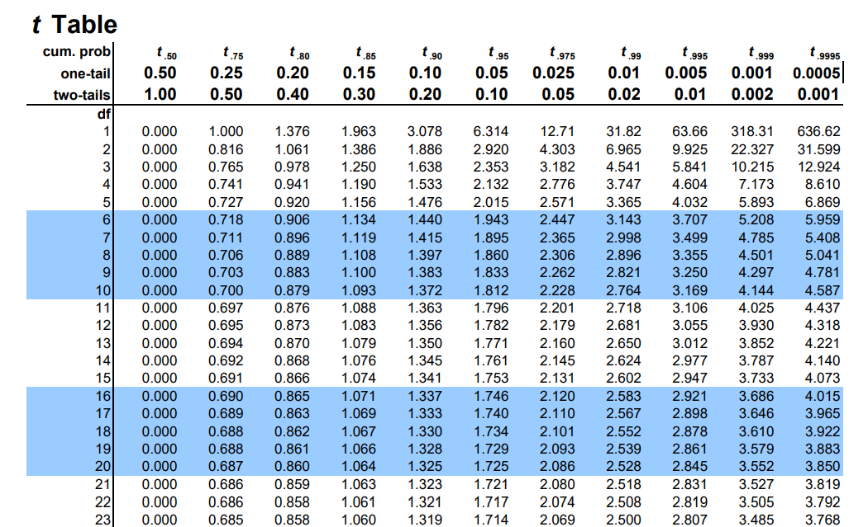
T-table

Slide 20
Degrees of freedom Example
Degrees of Freedom (DoF) represent the number of independent values that can vary in a statistical calculation.
Suppose you have 5 test scores (out of 100), and the mean is 80.
So, what is the sum of the scores?

Slide 21
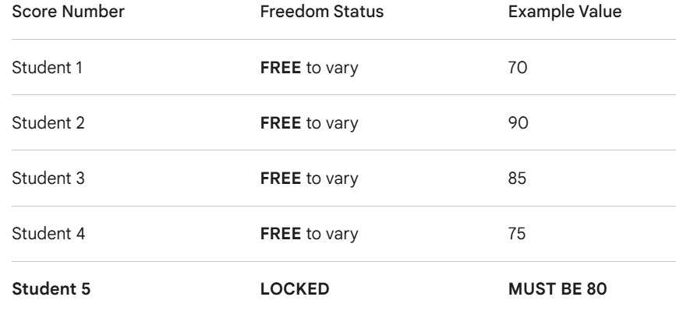
Degrees of freedom Example
Sum of the scores is 5 * 80 = 400
Now suppose the first four scores are allowed to vary freely.
BUT — once 4 of the scores are finalized, the fifth value is fixed to maintain the same mean (80) and sum (400).
Thus, Degrees of Freedom = n - 1 = 5 - 1 = 4

Slide 22
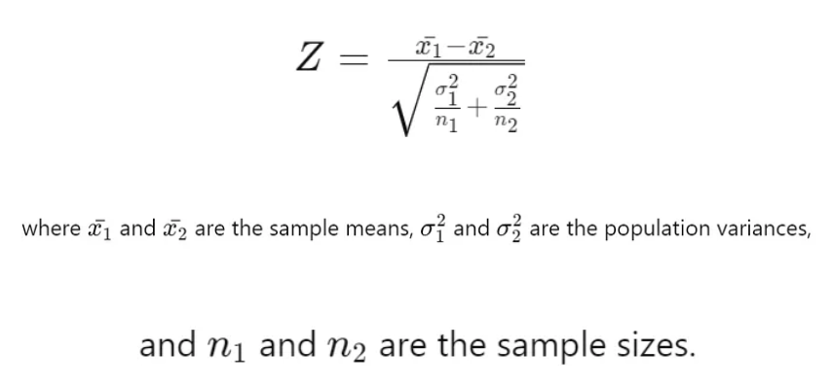
Testing of Mean – Two Independent sample
Testing of Mean – Two independent sample – Large Sample(>=30) and Population SD is known
Test-statistic:

Slide 23
Two Independent Sample Z-Test
Problem Statement:
A researcher wants to compare the average daily calorie intake of male and female adults in a city. Two independent random samples are taken:
Sample 1 (Males): n1=40, mean X1_bar =2500, population standard deviation σ1=300
Sample 2 (Females): n2=35, mean X2_bar=2300, population standard deviation σ2=250
At 5% level of significance, test whether there is a significant difference in the mean calorie intake between males and females.

Slide 24
Step 1: define the hypothesis
We conduct a two-sample Z-test because:
Sample sizes are large (n1,n2≥30)
Population standard deviations (σ1, σ2​) are known
Null Hypothesis (H0​): There is no significant difference between the mean calorie intake of males and females. H0:μ1=μ2
Alternative Hypothesis (H1​): There is a significant difference between the mean calorie intake of males and females. H1:μ1≠μ2
This is a two-tailed test.

Slide 25
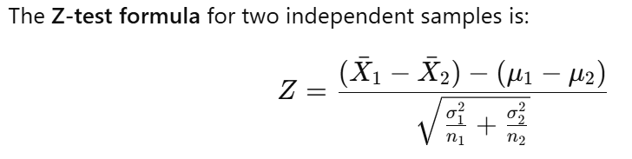
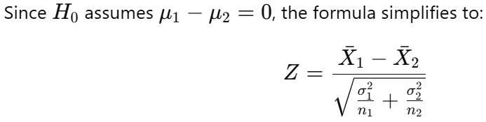
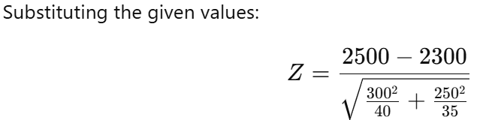
Step 2: Compute the Test Statistic
Z comes out to be ?

Slide 26
Step 3: Find the Critical Z-Value
For a two-tailed test at 5% significance level (α=0.05), we look up the Z-table:
Zcritical =±1.96
Step 4: Compare and Make Decision
Calculated Z-value = 3.15
Critical Z-value = ±1.96
Since Z-calculated > Z critical, we reject the null hypothesis H0​.

Slide 27
Step 5: Final Inference
There is a statistically significant difference in the mean calorie intake of males and females.
This suggests that gender has an influence on daily calorie consumption.

Slide 28
Session Summary
In this session, we have discussed about:
Understand when to use which statistical tests
Apply and practice the various steps of Hypothesis Testing
Understand the process of one sample and two sample tests.
Draw inferences and conclusion.
Understand the concept of degrees of freedom

Slide 29
Reference Links
Introduction to Hypothesis Testing
Frequently asked hypothesis testing interview questions and answers – part 1
Frequently asked hypothesis testing interview questions and answers – part 2
Frequently asked hypothesis testing interview questions and answers – part 3
Sampling methods guide
How to Collect Data Effectively: Methods, Questionnaire Design, and Data Sources Explained
Probability Distributions in Python
Step-by-Step Guide to Two-Sample Z-Test for Large Samples (Population SD Known)

Slide 30

THANK YOU
For any Query:
Website- www.onlinecu.in
Helpline no.: 1800 121 388 800

